Slide 1
Steps in setting up wood biomass production chains in protected areas
SILA NATIONAL PARK – ITALY

Slide 2
Information for the trainers:
This presentation is made base on Guidelines: „Steps in setting up wood biomass production chains in protected areas“
(Capacity building, capitalization of results and mainstreaming)
Don't‘ use this presentation without reading the Guidelines carefully
The presentation was prepared in the frame of EU funded project BIOEUPARKS

Slide 3
Table of content
1. Main steps in establishing a production chain
2. Technical requirements for establishing a production chain
3. Compliance with EU legislation and sustainability issues
4. Main problems and barriers
5. Alternative solutions to identified problems and barriers
6. Recommendations for policies at national and regional levels
7. Good practice examples

Slide 4
1. Steps in establishing a production chain

Slide 5
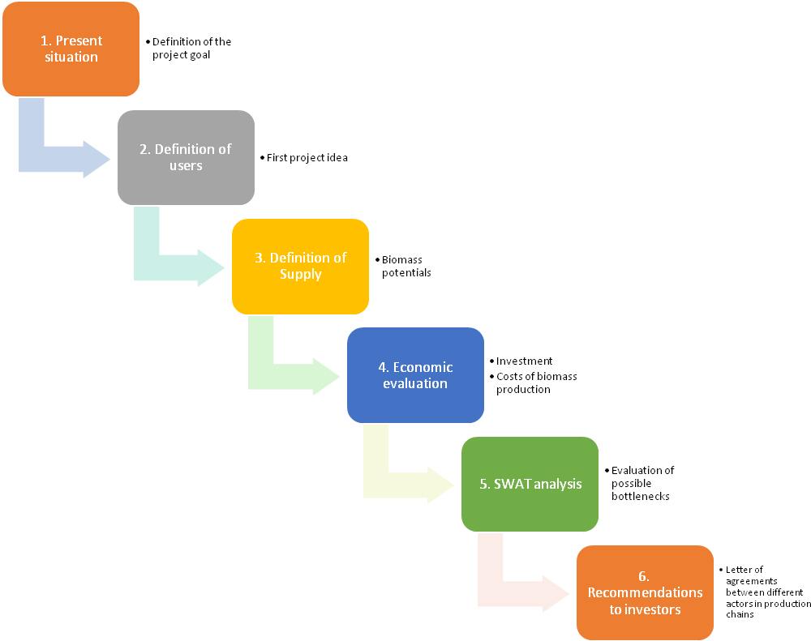
Main steps

Slide 6
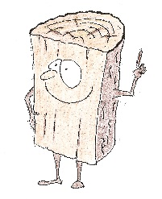
Analysis of the present situation
Main recommendation:
Don‘t spend to much time and resources in analyzing the present situation - only general information‘s are needed
Supply side
Biomass potentials
Wood biomass producers
Short overview of the wood fuel market
B. Demand side
Existing wood biomass users
C. Other issues
a) Existing environmental and other limitations
b) References

Slide 7
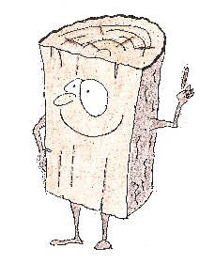
Definition of the goal - what do we want to achieve?
To increase the use of wood biomass inside the park area
To heat public buildings inside the park area with wood biomass, obtained through the maintenance of protected areas
To heat the settlements inside the park area
To heat the offices of the park administration with wood biomass from the park area
To produce wood fuels and sell them to inhabitants inside the park
To give the local population the rights to produce wood fuels inside of the park area
Main recommendation:
It is important to define the goal at the beginning. It should be discussed with main target groups.

Slide 8
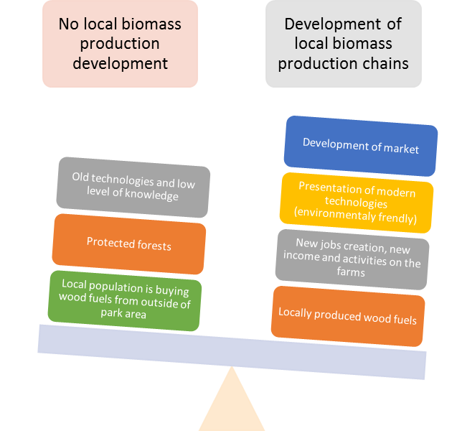
Possible impacts
Each of these goals include different steps and different project ideas
Main recommendation:
discuss different options, analyse different approaches and determine the goals at the beginning of the planning processes

Slide 9
2. Technical requirements for establishing a production chain

Slide 10
Wood biomass potential
Remark: ^{*1} this percentage is only an estimation, for example it represents the percentage of wood biomass from forests that could be used in a new wood biomass system – the present use of wood biomass in households and other existing heating systems should be taken into consideration.
Supply parameter | Estimation of theoretical potentials [1000 m³] | Availability for new wood biomass projects (in %)
Biomass from forests and other forest lands
Biomass from vineyards and orchards
Sawdust and wood residues in wood-processing industry
Fuelwood from other land uses with trees
Main recommendation:
Use simple questioner proposed in guidelines. Data can be estimations but it is important to be realistic when estimating the amount of biomass available for new planned system

Slide 11
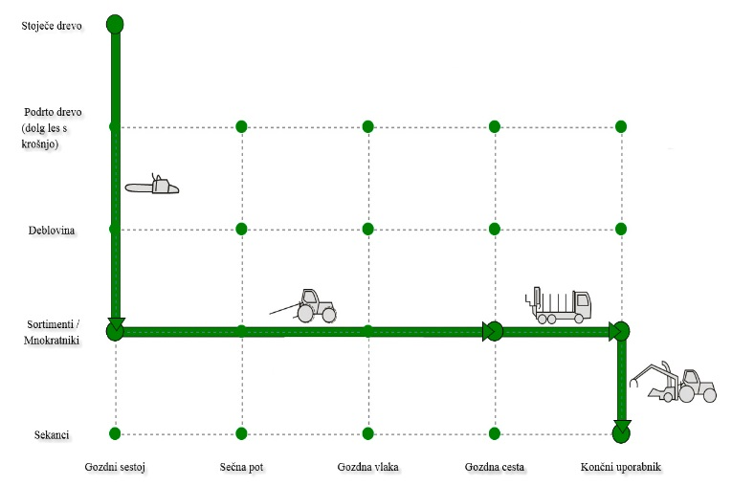
Wood biomass production technologies
Technologies should be selected:
According to viability of machinery in the region and traditions
According to terrain characteristics
According to costs
WoodChainManager
a free internet application can be used for visualization and cost calculation of selected machinery
Limitations from nature conservations should be considered
Main recommendation: WoodChainManager
http://wcm.gozdis.si/ can be used for calculation of costs for machinery

Slide 12
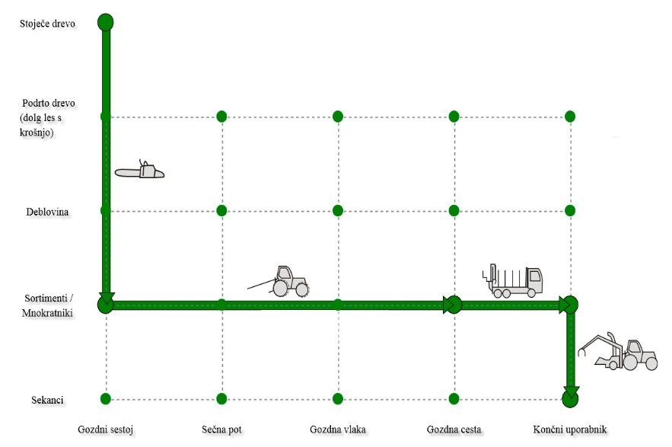
An example of production chain
Wood chips production: Chain saw, tractor, truck and chipper
Costs of machinery:
Machine | Total cost (€/h) | Direct material costs (€/m³)
Chainsaw (4 kW) | 4.0 | 2.1
Forestry tractor | 29.9 | 7.5
Single drum winch | 5.5 | 2.5
Forestry transport composition | 44.4 | 5.1
Standard tractor | 40.7 | 4.1
PTO Wood chipper | 74.1 | 7.4
Production chain costs | 198.6 | 28.7
http://wcm.gozdis.si/

Slide 13
Wood fuel producers
Type of wood fuel producers | Estimated No. of producers | Estimated annual production (t) | Available wood biomass for new buyers (t)
Wood log producers
Wood chips producers
Wood pellet producers
Sum
Main recommendation:
Answer simple question: Who is who in the park area? Use existing data from different existing registers and public available data.

Slide 14
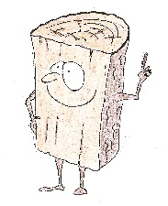
Estimation of new wood fuel consumption
Relevant only if a new wood biomass heating system in planned
Exact planning of heating system should be done by an expert
Simple calculations are available but only for first estimations - to be able to match supply and demand of wood biomass in the park area
Main recommendation:
Ask the expert!

Slide 15
3. Problems, barriers, participations, solutions
Economical
Environmental
Cultural
Social
Costs, profits, subsidies
Biodiversity, Natura 2000,
New jobs, local development,
Traditions, use of wood, use of forests

Slide 16
Legislation and sustainability issues
Regulations and sustainability criteria's for the park area should be considered and checked before starting biomass production chains in this protected areas
Main recommendation:
List all the possible limitations in the park area and discuss them with stakeholders

Slide 17
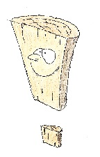
Involvement of target groups
Target groups (producers, users, public administration, forest owners, …..) should be identified
Roundtables should be organized to present the idea and to collect feedback
Project should be presented in different development stages to different target groups – involvement of local population and decision makers in crucial for the success
Main message:
Wood biomass production and use can be organized also in protected areas – without harming the protected environment

Slide 18
Main problems and barriers for further development of wood biomass production chains
Problems / barriers should be:
identified using SWOT method or any other similar participatory method.
identified by participation of main target groups
analyzed and take into account when planning the biomass production chains
Main recommendation:
Biomass projects need public support – ask, listen and than plan

Slide 19
Alternative solutions?
Main recommendation:
Win / win solutions should be found and promoted!
Modern technologies,
Grouping of forest owners,
Participation and Education of stakeholders
Involvement of local actors from the beginning
Support of local policy makers
Improving market conditions for wood fuel users and producers

Slide 20
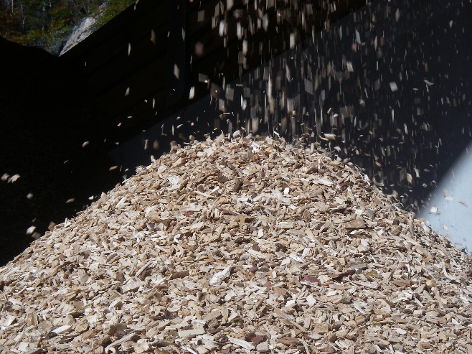
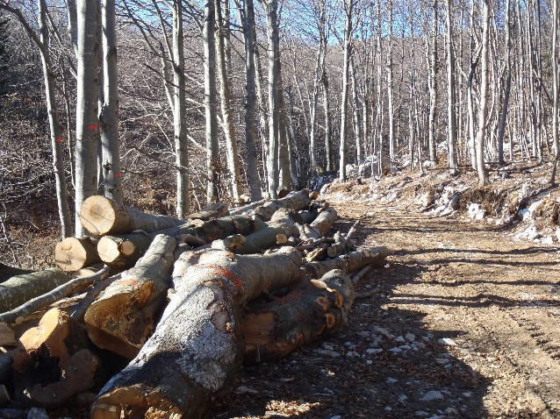
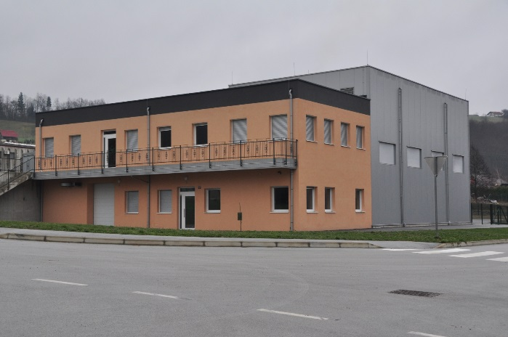
4. Good practice examples

Slide 21
Analysis of the present situation
Biomass potentials SNP
About 80% of the Park territory is covered with forests. More specifically, about 60.000 hectares, out of the 73.000 of the SNP area, are forests, distributed as follows:
Conifer forests 36.000 hectares (60,0 %)
Hardwood forests 15.700 hectares (26,0 %)
mixed forests 8.300 hectares (14,9 %)
Conifers
The forests of Sila National Park that are potentially suitable to supply biomass occupy an area of about 28.000 HA, entirely in zone C. More specifically, the area involved in the plan is up to 13.000 ha conifers, representing 50% of SNP areas, almost exclusively composed by Corsican Pine var Calabrica or Corsican Pine mixed with beech.
Present day scenario
From the analysis of data concerning land cover in SNP, it can be argued that the production of biomass for energy purpose, based on conifer forests.
The availability goes down again due to lack of forest management plans is, currently up to around 5.200 tons/year.

Slide 22
Hardwoods
As regards hardwoods, 12.000 ha of SNP area, also included in zone C, will be involved.
More specifically, hardwoods forests can be identified into 9.000 ha of beech forests and beech forests mixed with other hardwoods. Most of these SNP forests are not included in any Forest Management Plan, therefore, their exploitation is up to the owner (either private or public) who asks Calabria Region for a cut permission.
Present day scenario
From the analysis of data concerning land cover in SNP, it can be argued that the production of biomass for energy purpose, based on hardwood forests. The availability goes down again due to lack of forest management plans, is currently up to around 3.035 ton/year.

Slide 23
Wood biomass users
Gli utilizzatori di combustibili da biomasse (cippato) rimangono principalmente le grandi centrali termoelettriche operanti in provincia di Crotone e Cosenza ed in secondo ordine (legna da ardere e pellet) i nuclei familiari residenti nel territorio del SNP.
Environmental and other limitations
Gli ostacoli alla produzione di combustibili da biomassa possono essere di diversa natura, alcuni dovuti a problematiche orografiche (pendenza dei versanti), ed altri legati alla viabilità forestale a volte del tutto assente.
Inoltre va ricordato le limitazioni legate alle normative vigenti nella Regione Calabria e soprattutto alla natura protezionistica del SNP

Slide 24
Legislation and sustainability issues
Forest cuts in the Park area are subject to three main regulations:
Calabria Region’s forestry law (L.R: n.45 2012) “Management, protection and valorisation of the regional forestry heritage”
laying down general rules and guidelines to improve sustainable forest management designed to preserve the territory and fight against climate change. This law aims at strengthening forestry supply chain starting from the production level in a way that ensures, in the long term, the multi-functionality and diversity of forest resources. This law also says which forestry interventions can be realised.
General Provisions and Forest Police Provision (GPFP) laying down technical and administrative rules for the use of forests.
These provisions state that, in order to obtain cut authorisations, public and private forest owners have to present a project drafted by a qualified expert. The following rules apply:
Coppice
Depending on species, the choice of forestry practices have to comply with technical guidelines included in the chapter “Sustainable forest management” of the Regional Forestry Plan.
The choice of seedlings have to be made according to criteria laid down in art. 43 (coppice of two rotations system) and art. 44 (coppice with standards).

Slide 25
High forest
The planned felling quantity is determined according to section IV of the chapter “Sustainable forest management”. The management system has to involve, depending on the forest population and temperament of species, a selective regeneration cut “for small or very small groups” not larger than 200 square metres.
Thinnings, in natural formations have to consist in selection interventions “from below, of low or moderate degree” in relation to population structure, temperament of species and plant health conditions.
SNP management plan
Art. 23 – Interventions in forests and tree cuts
Zones A (integral natural reserve)
Any sylvicultural intervention is forbidden
Zones B (oriented general reserve), C (protected areas for traditional uses) and D (areas of economic promotion)
Sylvicultural interventions (forest utilisations, thinnings, prunings, plant health cuts, etc…) must be authorised by the Park following explicit request.
Zones B
In corsican pine, beech, oaks and other high forests, forestry utilisations are allowed (based on selection cuts) with an utilisation rate of 1,5%.
Zones C and D
Thinnings can be made according to GPFPs.

Slide 26
Definition of the goal
To heat public buildings inside the park area with wood biomass, obtained through the maintenance of protected areas
To heat the offices of the park administration with wood biomass from the park area
To produce wood fuels and sell them to inhabitants inside the park

Slide 27
Possible impacts
IMPACT OF BIOEUPARKS PROJECT
Social impact
During the last years, the massive introduction of natural gas in Calabria determined a sudden and serious loss of energy self-reliance of local communities that had to go through systematic fossil fuel supplies, being exposed to their effects in terms of price volatility.
In general, social benefits connected to biomass use refer to improved life standards, lower emissions compared to harmful fossil fuels, job opportunities for locals and sustainable use of woodlands.
In this project, the substitution of boilers and the introduction of biomass fuels will allow the Sila National Park to play a leading role in the community: the use of local biomass represents and added value for local economy.
The money needed to buy pellet to fuel boilers will no more be destined to other countries or to oil transnational companies: on the contrary, it will create a virtuous circle for the local community.
Keeping the money within the local economy will, in turn, help revitalise other activities.
Environmental Impact
Environmental benefits deriving from the use of biomass for energy purpose are widely acknowledged.
The use of biomass rather than fossil fuels allows to avoid the emission into air and soil of huge amounts of CO2 and other polluting elements. While burning, biomass emits the same amount of CO2 it has accumulated during its life. Moreover, emissions linked to the transportation of biomass to thermal power stations will be avoided.
Economic Impact
The use of biomass, mainly from forestry processing residues, will favour the development of a local, forest-based economy where companies and experts may start businesses and create jobs with concrete impact on the territory. The demand of wood for energy purpose stimulates the re-organisation and development of the supply chain, involving agriculture and sylviculture, wood-processing companies and transport companies and providing them with opportunities for more income or the start of secondary activities.

Slide 28
Process of participation and capacity building in the area
Stakeholders involvement process
Methodological approach
The Local Action Plan for the creation of a biomass supply chain was conceived as a living document, undergoing a process of co-planning with local stakeholders likely to be involved directly or indirectly in the supply chain.
The Sila National Park has drafted this strategic overview of the plan based on the analysis of the available data and feedbacks from awareness-raising events held between September and November 2013, which local stakeholders (forest owners, forestry companies, transport companies, public authorities) actively took part in.
During these events, the SNP made the decision of drawing the detailed plan after further discussion that would take place in specific meetings scheduled in February/March 2014, with the goal of starting the supply chain activities in the beginning of April 2014.
During these specific meetings, some crucial themes were approached: energy and plants, Structural Funds incentives, financial management of the supply chain, forestry and energy certifications. Besides the key-actors of the supply chain, trade associations, professional organisations, research institutes, local authorities and representatives of Calabria region were invited.
The result of this process is the detailed identification of:
companies interested in supplying services and products linked to biomass-based heating, with particular reference to the sector of heat/electricity generators linked to district heating systems and solid biomass cogeneration;
project designers, building companies and owners of buildings (both public and private ones) interested in installing biomass heating systems in buildings under their property or responsibility;
economic actors interested in developing cooperation in the sector of biomass heating, including biofuel supply chain.
The final goal of this participation process is to identify forms of cooperation, under the direction of SNP, between one or more fuel suppliers and final users, in order to ensure, for each plant, a stable supply in terms of quantity, quality and cost.
The SNP’ supervision will ensure the environmental sustainability and the environment-friendly nature of all processes.

Slide 29
Work done activation supply chain
The sector of forest biomass for energy purpose has rapidly developed over the last years, in Calabria too. This development is related to the most recent policies in the energy field that, on the one hand, caused an increase of fossil fuels prices and, on the other hand, provided regulations and incentives for the exploitation of renewable sources of energy. Indeed, the largest part of wood extracted from Sila National Park (SNP) is currently used by thermal power plants in Crotone and Cosenza provinces.
Thus, thanks to the Bioeuparks project, a new approach to forest biomass exploitation within the Park area has been adopted. This approach is based on principles of environmental and social responsibility that include using biomass to supply small and very small-sized plants, as close as possible to the production area, looking to create a sustainable and socially accepted model.
To favour this process, during the start-up phase of the supply chain the SNP authority has played the role of final user of the biomass produced in the Park area or within 50 km distance from its borders. The supply chain was started by publishing a tender for the supply of pellet by local producers.

Slide 30
The process of building the supply chain started with the involvement of territorial stakeholders to analyse the present-day biomass market situation and the feasibility of a short supply chain based on environmental, social and economic sustainability.
During numerous public meetings and roundtables, it emerged that biomass produced in the Park area is entirely absorbed by thermal power plants of Crotone and Cosenza provinces.
The Park has therefore started a process to elaborate and share with stakeholders a different approach to forest resources management whose pillars are the short supply chain, environmental and social sustainability and the promotion of local scale energy districts.

Slide 31
Sila park supply chain

Slide 32
Energy production
ENERGY PRODUCTION
The production of electricity and thermal energy is realised through thermal machinery fired with wooden fuel (chips, pellet, etc…) that may have different functioning and different performances in terms of efficiency.
The figures concerning potential energy production, depending on the potential conifer and hardwood biomass supply described in the previous paragraphs, are showed in the table below. As the table points out, there is currently no production of thermal energy. Indeed, no district heating system using the thermal energy produced by plants within a range of 50 km distance from the SNP territory exists up to this day.
As regards the planned stations, the ones located in the Park seat and in Longobucco, technical specifications are described below:
Technical specifications - SNP seat station
The boiler the Park is going to start will represent an effective alternative to traditional boilers fed with gas or liquid fuels (methane, LPG, gasoline), thanks to its cheap management due to the low market price of fuel. The boiler will be able to burn various kinds of solid, middle-sized fuel, such as wooden chips, sawdust, pine nut and almond shells, pellet, olive pomace, etc.

Slide 33
Besides the boiler located in the SNP headquarters, some boilers for the heating of other buildings (all of them run by the Park) will be operated during this year. In particular:
Due to logistic problems, that is, because it is not possible to store a sufficient quantity of wood chips to feed the boilers, pellet will be used instead. Pellet is produced from residues and waste of first wood processing in local sawmills.

Slide 34
Bando di gara
Secondo quanto stabilito dalle linee guida del Progetto nella prima fase, mediante appositi incontri (specific meeting) e stato realizzato il Piano Locale necessario alla costituzione della filiera per l’approvvigionamento di biomasse locali - (Localized Supply Chain Plan) da utilizzare negli impianti di riscaldamento in uso nelle strutture del Parco, (sede del Parco, sedi CTA, locali Museali, etc.). Nella seconda fase del Progetto Bioeuparks è previsto l’ampliamento, il consolidamento e l’attivazione della filiera corta nel territorio del Parco Nazionale della Sila, pertanto, l'Ente Parco Nazionale della Sila, ha proceduto all’affidamento per la FORNITURA PELLET PER CALDAIE PER LA PRODUZIONE DI CALORE IN LOCALI GESTITI DAL PARCO NAZIONALE DELLA SILA acquisendo offerte idonee in base alle finalità del progetto Bioeuparks -

Slide 35
L’affidamento del Servizio avverrà secondo la seguente procedura dell’art. 125, comma 11, del Codice degli Appalti.
11. Per servizi o forniture di importo pari o superiore a quarantamila euro e fino alle soglie di cui al comma 9, l’affidamento mediante cottimo fiduciario avviene nel rispetto dei principi di trasparenza, rotazione, parità di trattamento, previa consultazione di almeno cinque operatori economici, se sussistono in tale numero soggetti idonei, individuati sulla base di indagini di mercato ovvero tramite elenchi di operatori economici predisposti dalla stazione appaltante. Per servizi o forniture inferiori a quarantamila euro, è consentito l’affidamento diretto da parte del responsabile del procedimento. (comma così modificato dall’art. 4, comma 2, lettera m-bis), legge n. 106 del 2011)

Slide 36
La fornitura complessiva sarà pari a 1974 q.li di cui sarà eseguita una prima fornitura per i mesi di ottobre, novembre e dicembre 2015 per una quantità pari a 987 q.li nelle sedi di consegna indicate nel prospetto.
La seconda fornitura sarà effettuata a gennaio, febbraio, marzo 2016 per le stesse quantità sopra riportate.

Slide 37
Monitoring phases
Monitoring of logistics and biomass transformation
Besides the above-described laws and regulations, the SNP will adopt the so called Track and Trace system in order to verify the origin of wood. This control will apply from the first supply, in October 2015. The supplier will have to submit the documents needed to allow full traceability of the product, in particular:
Cutting authorisation issued by Calabria Region, identifying the place where cut will be carried out;
Wood purchase contract;
Report signed by the forestry works director specifying the processing steps carried out, the place of origin of wood consistently with provisions laid down by the Track and Trace system described in the LSCP (Localized Supply Chain Plan);
Declaration stating that pelletisation has been made within the SNP area (or within 50 km distance from its borders), in case the pelletisation plant does not belong to the supplier.
The SNP will be responsible for controlling all phases along the supply chain and may ask any accredited laboratory to carry out analyses on the products and assess their compliance to the required standards. Furthermore, all processing steps, both in woodland and during pelletisation, will be constantly verified: check reports will be signed also by the supplier.

Slide 38
Monitoring of project indicators
Due to potential risks linked to an irrational development of the sector, there is the need to identify indicators and some measures for the mitigation of possible negative impacts on legal, environmental, economic, or social aspects.
Legality and social/environmental responsibilty
A wood-energy supply chain has to comply with principles of legality and social/environmental responsibility. All actors are tied to the full respect of laws, also considering that the supply chain is realised within a protected area.
The main issues in the context of legality are:
occupational health and safety, also due to the nature of forestry sector, presenting certain risks for workers. Indeed, forestry works imply health and safety risks linked to steep and uneven soil or to extreme climate conditions. These problems are usually increased by the lack or inadequacy of first aid structures in workplaces and appropriate work clothing.
Traceability of feedstock, as a parallel feedstock import sector exists. It is important that all wood biomass participants comply with EU regulation n.995/2010 that dating from 3rd March 2013, requires all European actors to adopt appropriate procedures reducing the risk of importing wood products of illegal origin.
Prevention of environmental damage: the supply chain involves issues related to the management of woodlands and emission of pollutants.

Slide 39
Protection of environment
The use of wood for energy purpose is often encouraged, due to its positive effects on the environment. This is why monitoring the actual environmental impact of the wood-energy supply chain is extremely important. To ensure an appropriate management of raw material, particularly in the early steps of the supply chain (from woodland to sawmill), may help protect forest ecosystems and biodiversity, as well as avoid biomass waste.
Besides protecting the ecological functions of woodlands, an accurate forest management (through thinning interventions and the removal of residues after forestry works), also in hard-to-access areas, reduces the risk of fires and soil erosion.
Carbon neutrality (that is, of CO2 emissions) represents a fundamental difference between biomass and fossil fuels and is the main justification of public interventions in this field. It is important, therefore, to monitor an reduce emissions caused by the production and transport of biomass during the steps of the supply chain.

Slide 40
Local Development
The creation of the supply chain in the Sila National Park area will build a closer connection between local consumers and biomass harvesting areas. This may present, in turn, a more transparent image of the territory and consequently stimulate local economies.
Furthermore, the creation of local supply chains implies reducing distances for the transport of feedstock and decreasing CO2 emissions. Other important effects include:
the reduction of “intermediaries” involved in the process, leading to a fairer distribution of the added value among the players and to a better remuneration for biomass producers;
the sustainability of the production phase, improving the inclusion of local producers in the social context and reducing risks of conflict with the population;
the promotion of new local markets, creating new jobs along the supply chain, slowing down rural depopulation, and improving local skills related to harvesting, processing and transport of wood.

Slide 41
Stimed Performance

Slide 42
IDENTIFYING NEW POTENTIAL INVESTORS AND CONSUMERS OF BIOMASS
In this context, being a public territorial body focusing on habitat conservation and environmental education, the Sila National Park authority will merely play the role of creating connections among partners and helping match demand and supply of forest biomass.
The meetings held during the last years have showed that the forest owners and small forestry companies play a minor role in supplying biomass to the thermal power plants of the territory as they hardly manage to aggregate their productions and obtain sufficiently big lots to meet the demand.
On the contrary, small biomass plants, as the one being completed in the Longobucco town hall, and small heating boilers, as those of the Park’s buildings are fit for attracting smaller biomass supplies and therefore creating a locally-based virtuous circle.
However, to be competitive on the fuel market, forest owners need to be able to ensure regular and sustainable supplies. In a local energy market characterised by a limited mobility, this could represent a crucial asset.
The buyers of biomass for energy purpose need:
the supply of biomass on a sustainable basis;
the assurance of a minimum supply.
Thus, an improved organization of wood fuel production can be convenient for the final users, as it is based on the clear knowledge of the parameters determining the quality of the fuel and leading to the standardisation of the product quality.

Slide 43
At the same time, the development of an efficient logistics will be favoured, together with a close cooperation among the stakeholders and an acceptable level of security and sustainability of feedstock supply. A balanced production system may, in turn, have positive social and environmental impacts.
Finally, the project partners are aware that biomass production for energy purpose can revitalise a stagnating rural economy, in various ways:
by increasing the value of forestry and agriculture subproducts;
by favouring a more intense cooperation among the actors of territorial management;
by allowing a faster recoupment of investments in processing machineries and facilities;
For this reason, even after the constitution of the supply chain, Sila National Park authority has continued to meet with economic actors within the park area in order to enlarge the supply chain.

Slide 44
ENLARGEMENT SUPPLY CHAIN
A questionnaire was sent to these potential stakeholders (e.g. hotel and restaurant owners) in order to carry out a census of biomass boilers operated in their facilities and raise their interest in participating in the supply chain.
The interested stakeholders were then invited to attend a meeting held on the 27/05/2015. The proposal of creating a GAS (Solidarity Purchase Group) –augmenting the overall quantity of biomass to purchase and obtaining a better price from the producers - was made during the meeting.

Slide 45
Main lessons learnt
Il Parco Nazionale della Sila nella consapevolezza che il settore legno-energia, rappresenta un parte fondamentale della economia montana, e che esso continuerà a crescere nel prossimo futuro a cercato con la costituzione della filiera corta di elaborare una nuova regolamentazione delle norme volontarie per garantirne la sostenibilità e un commercio più equo, al fine di evitare impatti sociali e ambientali negativi.
In conclusion, the arguments presented so far highlight a crucial point: the challenge of a sustainable development of wood biomass sector is not merely a technical issue but involves governance and organisational aspects that represent a true test bed for the public and private actors undertaking this process.

Slide 46
Thank you!
www.bioeuparks.eu

